Slide 1







【 AI應用教育訓練】
立體建模及網頁圖磚產製
內部分享
技術研發部
三課 (遙測技術與AI解決方案)
演算法工程師
Notes:
https://en.wikipedia.org/wiki/101_(topic)

Slide 2
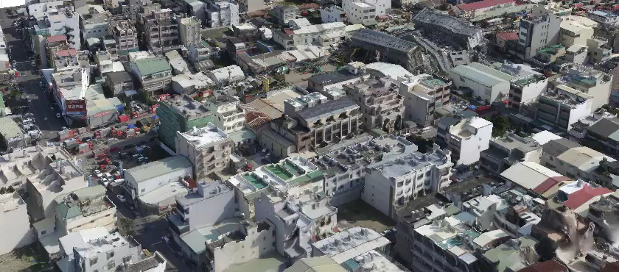
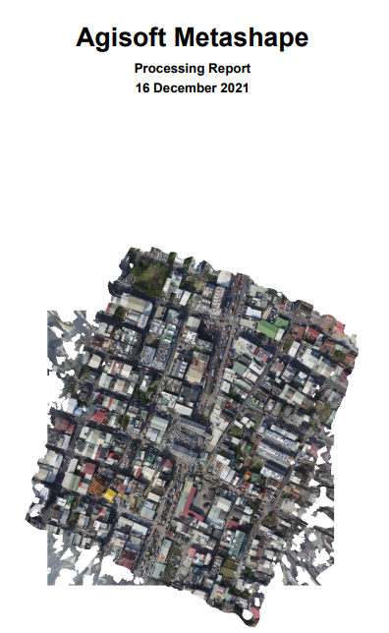
Outline
說明Agisoft為何以及使用上的一些版權限制。
開發環境設定及安裝相關軟體。
以實際場域影像產製立體建模結果及產出成果報告
說明三維圖台Cesium為何。
將建模結果轉換為網頁圖磚。
本地端網頁server 及CORS限制問題。
圖磚網頁成果展示。
立體建模
網頁圖磚
成果展示

Slide 3
立體建模

Slide 4
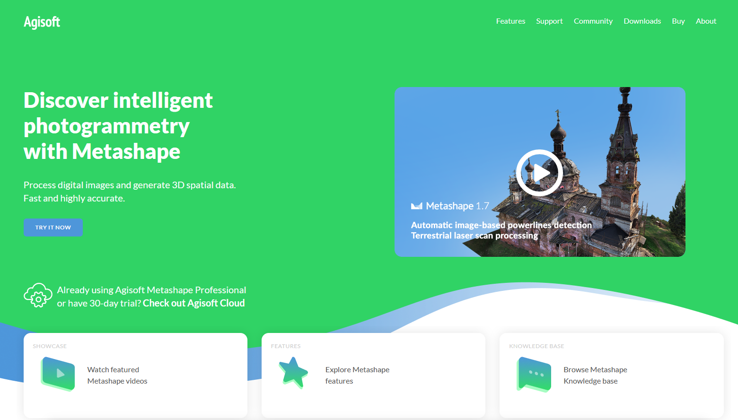

Slide 5
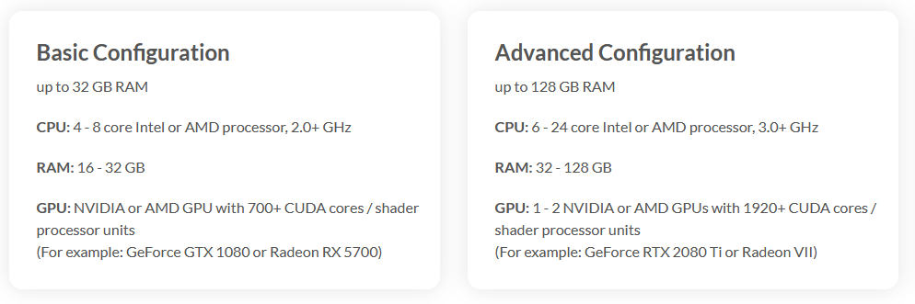
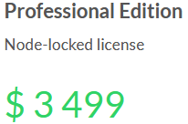
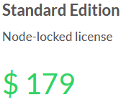
硬體限制
版權規範
Node-Locked License
Floating License
Educational License

Slide 6



Agisoft Metashape (30 days trail)
GUI : https://s3-eu-west-1.amazonaws.com/download.agisoft.com/metashape-pro_1_7_5_x64.msi
API: https://s3-eu-west-1.amazonaws.com/download.agisoft.com/Metashape-1.8.0-cp35.cp36.cp37.cp38-none-win_amd64.whl
A free stand-alone software to visualize 3D data. Measure distances, areas, volumes; calculate profiles; draw polylines, polygons.
https://s3-eu-west-1.amazonaws.com/download.agisoft.com/viewer_1_7_5_x64.msi
Agisoft Viewer (All Free)
Texture De-Lighter
A free stand-alone software to remove shadows from model textures.
https://s3-eu-west-1.amazonaws.com/download.agisoft.com/delighter_1_7_5_x64.msi

Slide 7
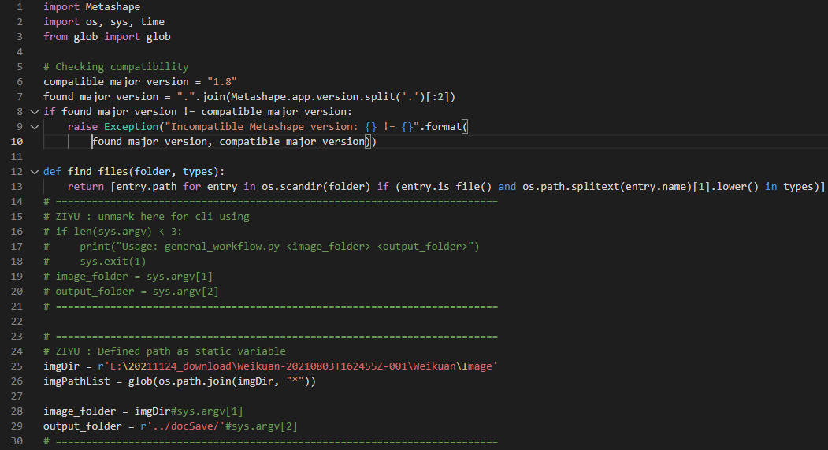
workflow.py

Slide 8
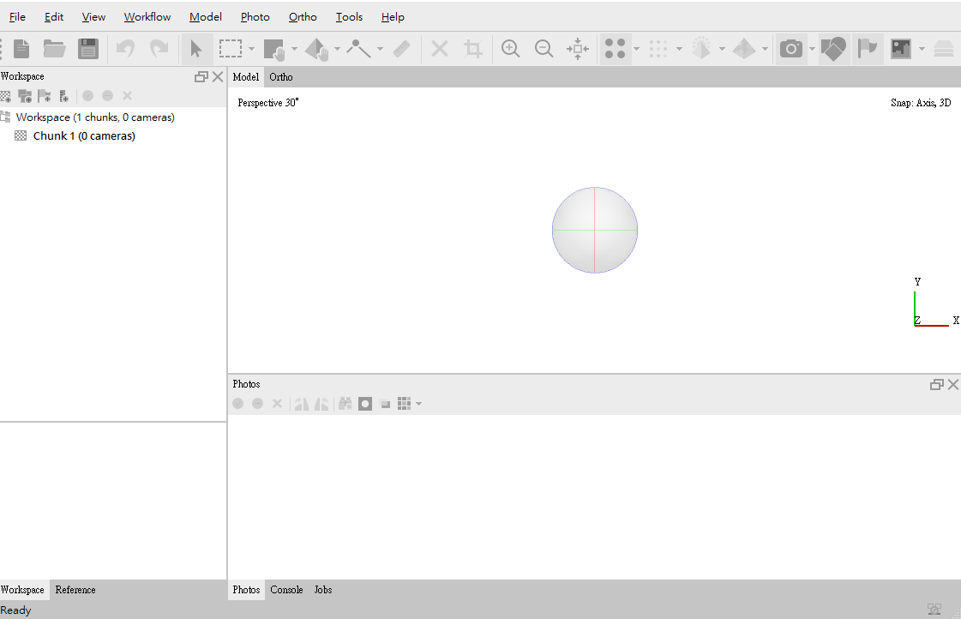
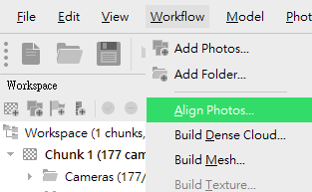
Add photo in chunk
Then make matching.

Slide 9
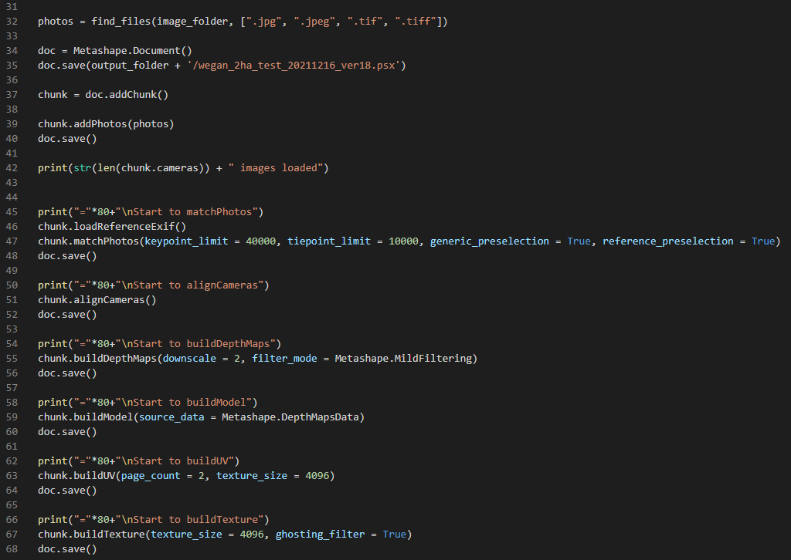
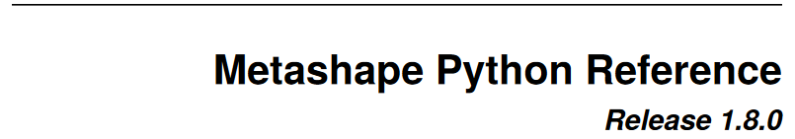
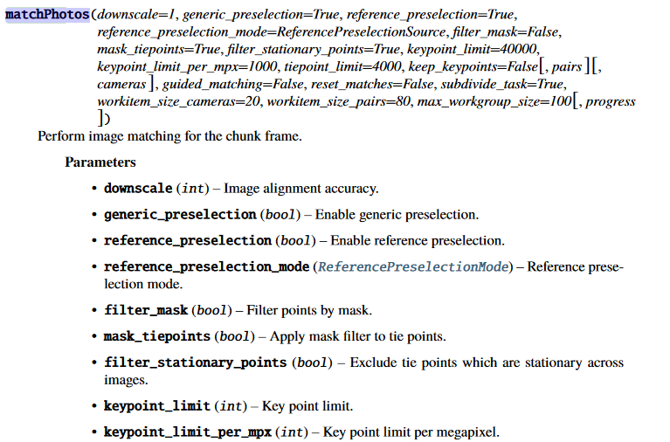
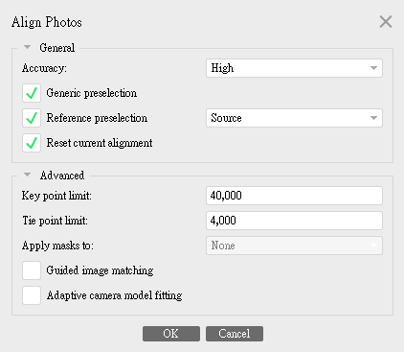
https://www.agisoft.com/pdf/metashape_python_api_1_8_0.pdf
For matching accuracy: Highest = 0 High = 1 Medium = 2 Low = 4 Lowest = 8

Slide 10
For matching accuracy: Highest = 0 High = 1 Medium = 2 Low = 4 Lowest = 8 For depth maps quality: Ultra = 1 High = 2 Medium = 4 Low = 8 Lowest = 16

Slide 11
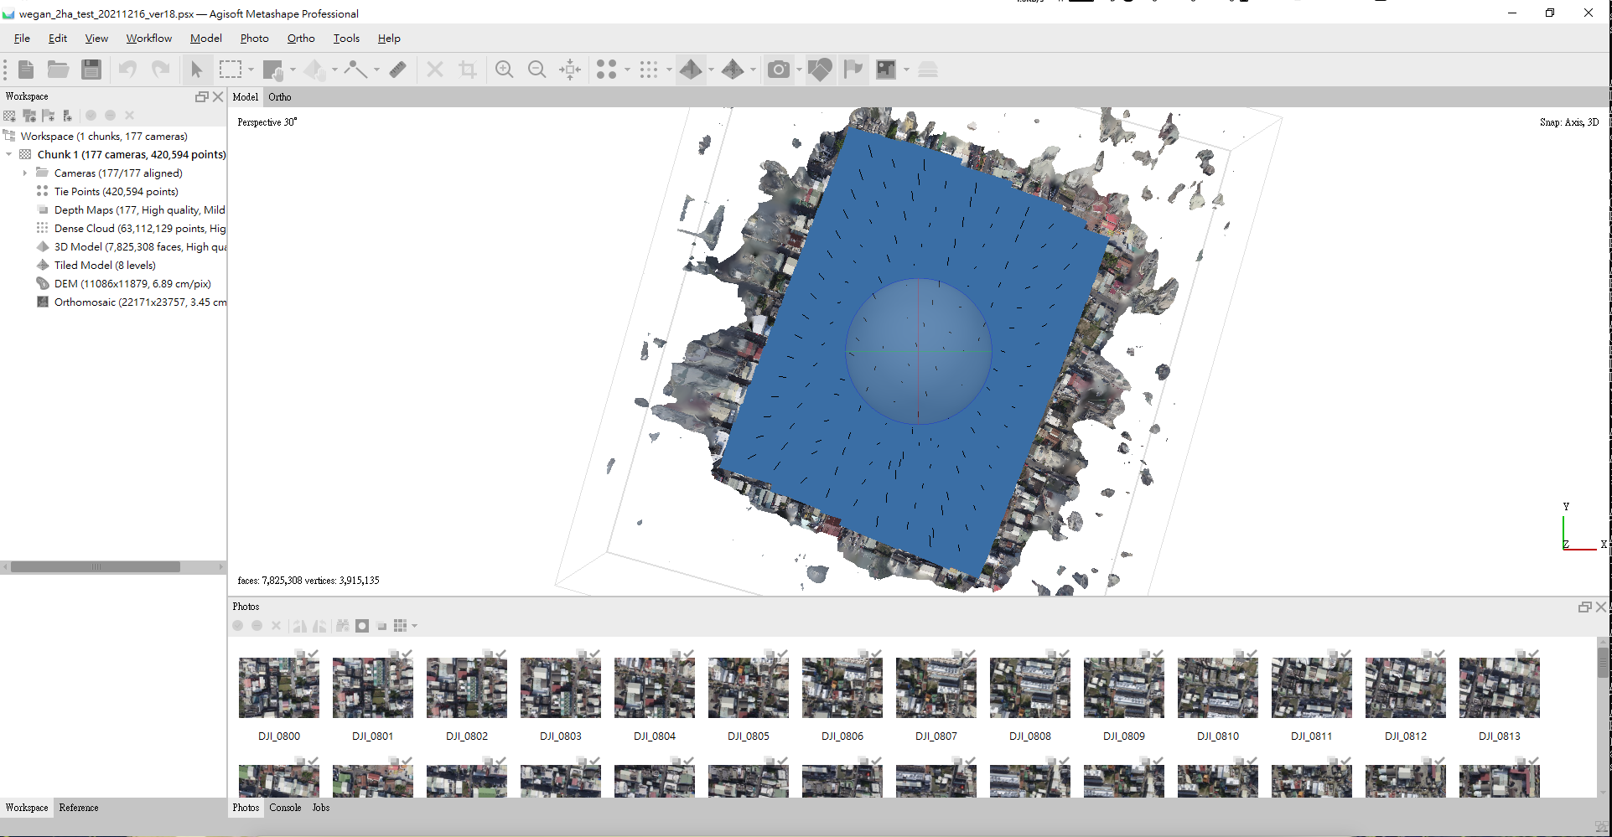

Slide 12
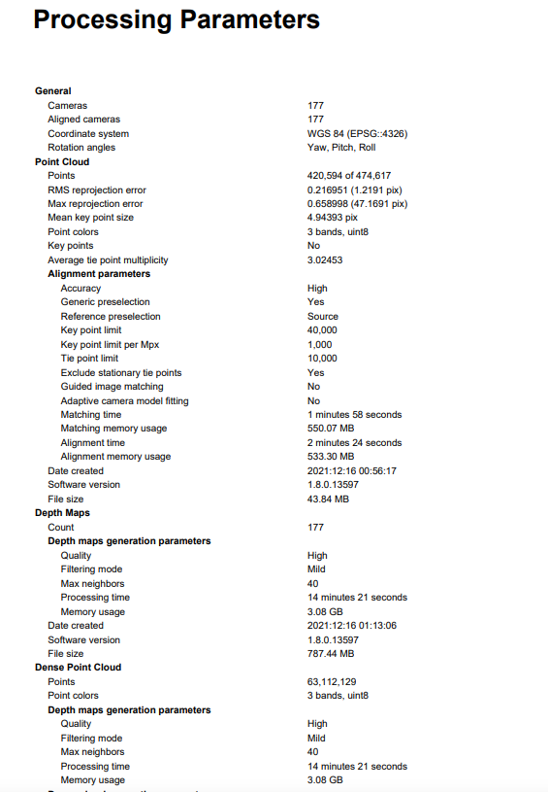
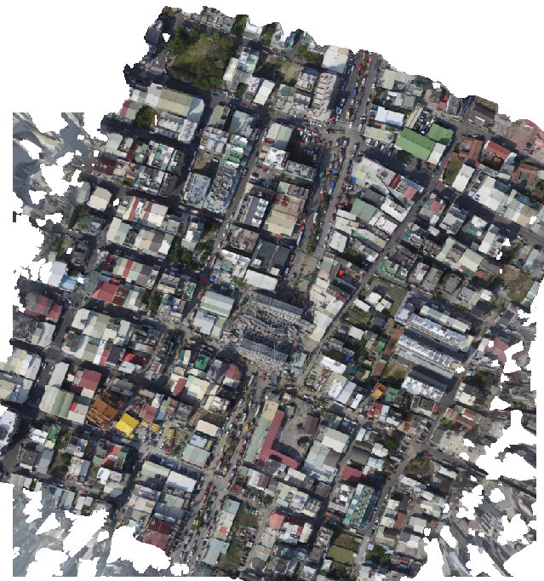
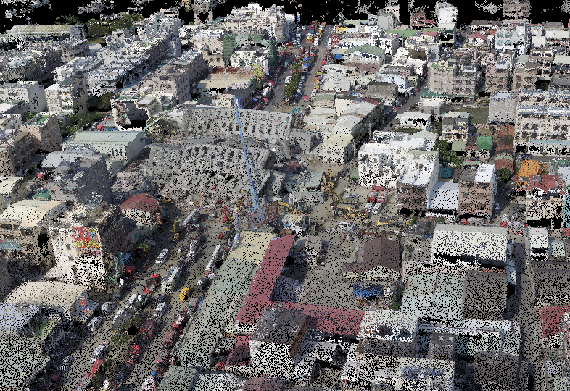
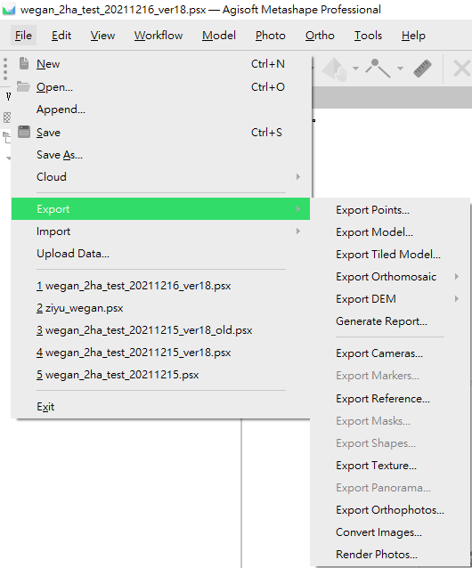
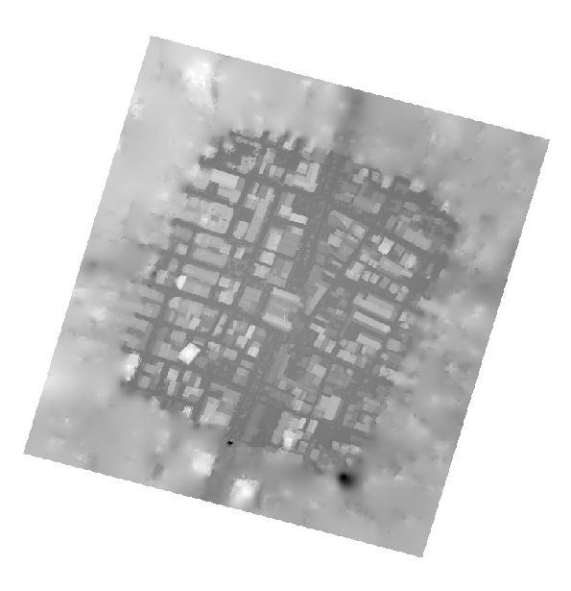

Slide 13
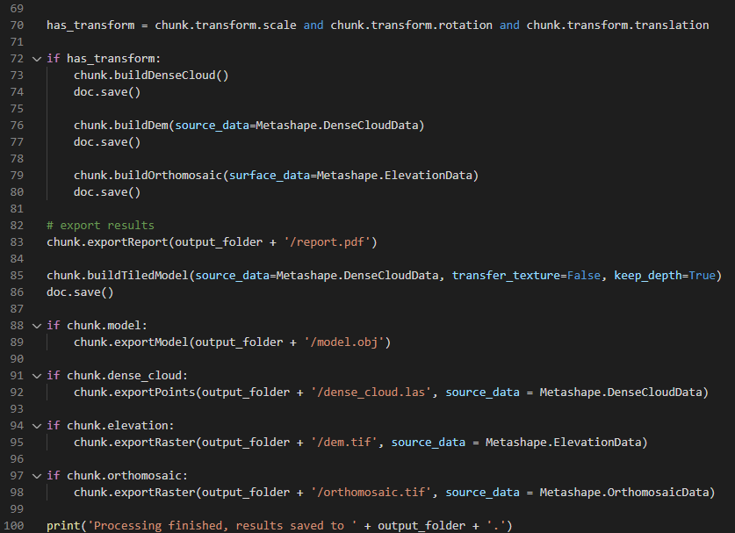

Slide 14
網頁圖磚

Slide 15
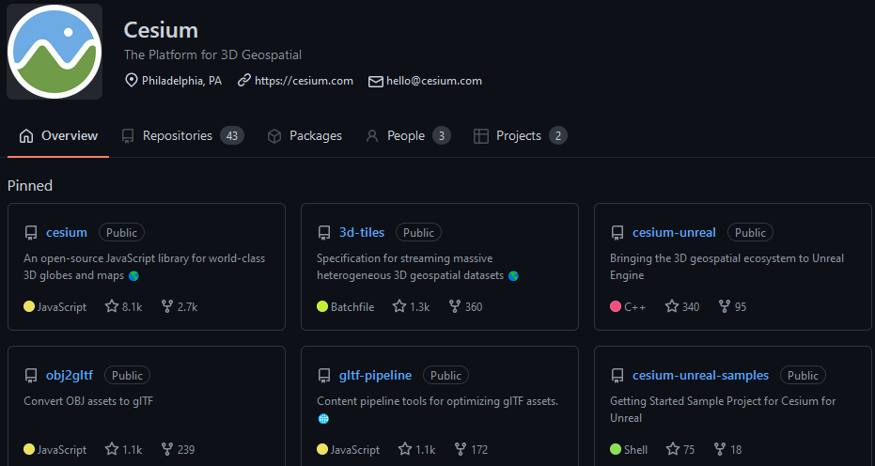
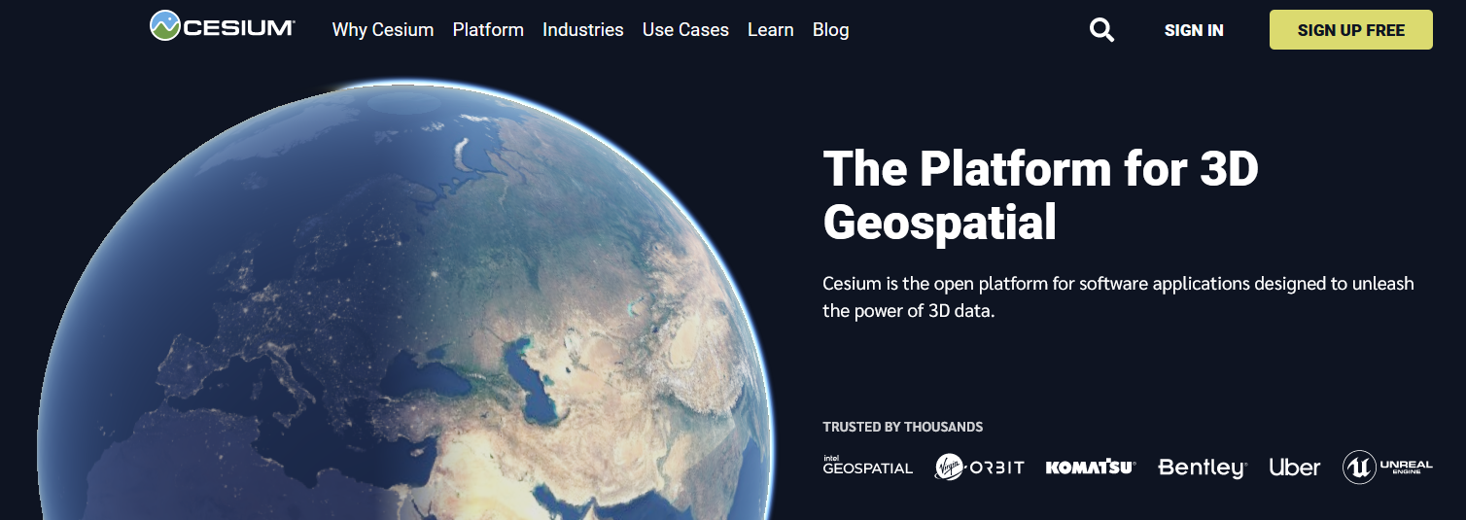
Live Example：https://sandcastle.cesium.com/?src=3D%20Tiles%20Point%20Cloud.html

Slide 16
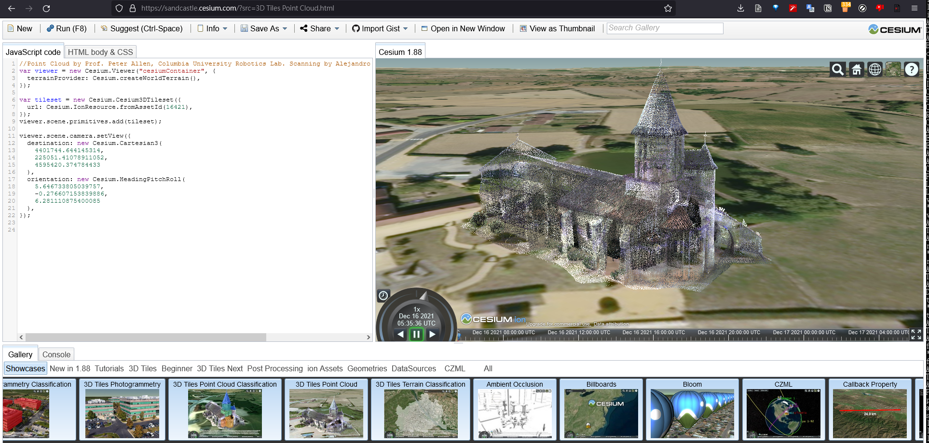

Slide 17
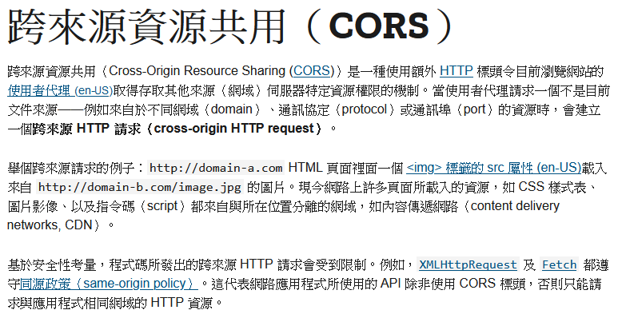
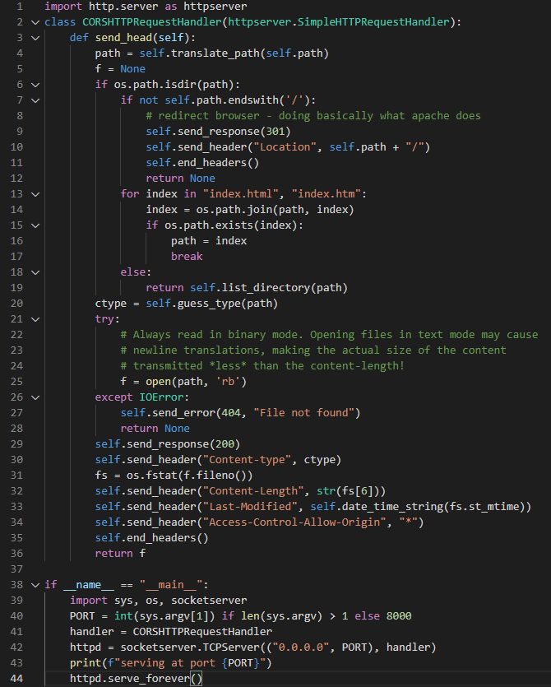
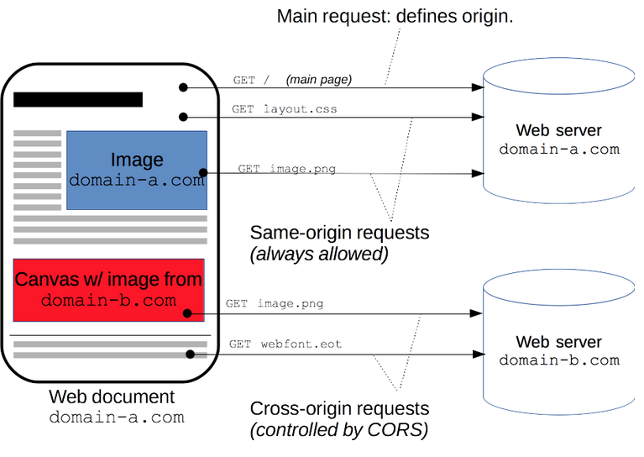

Slide 18

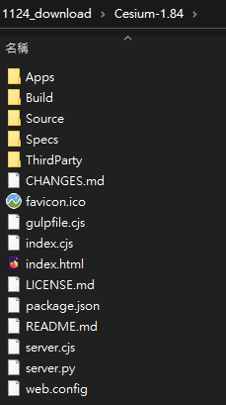
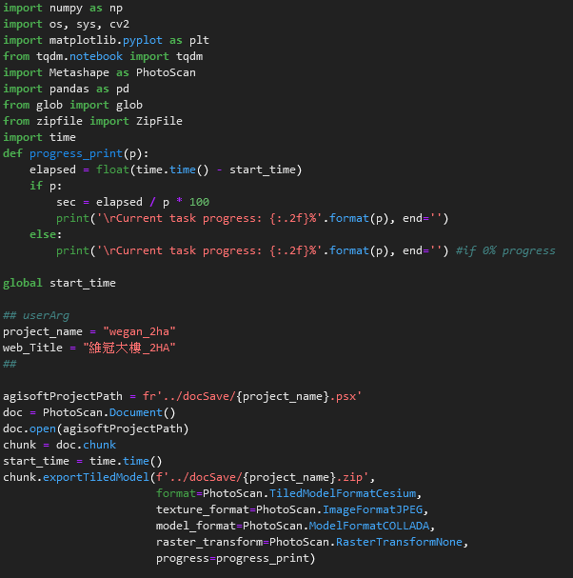

Slide 19
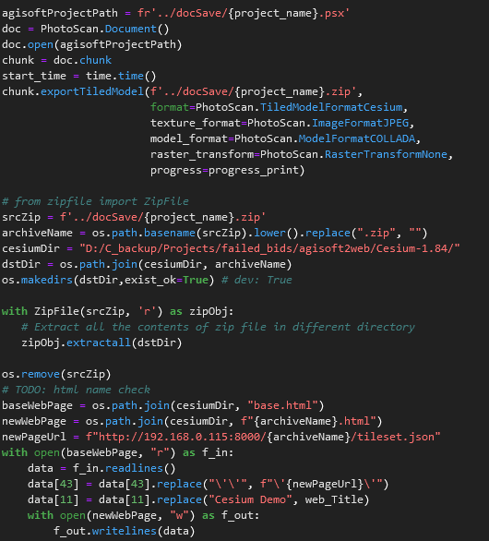
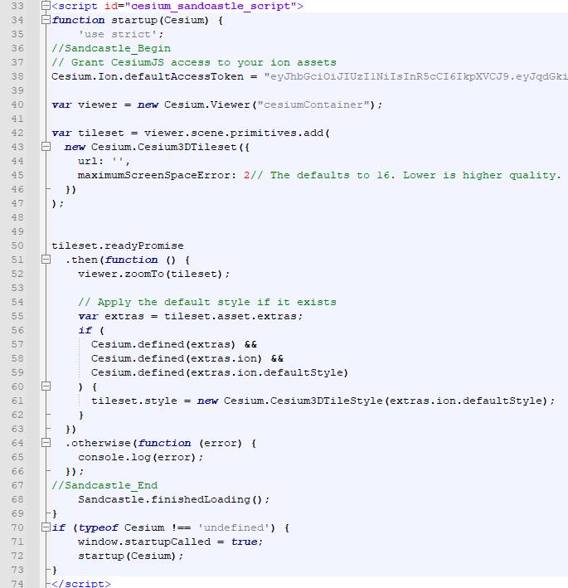

Slide 20
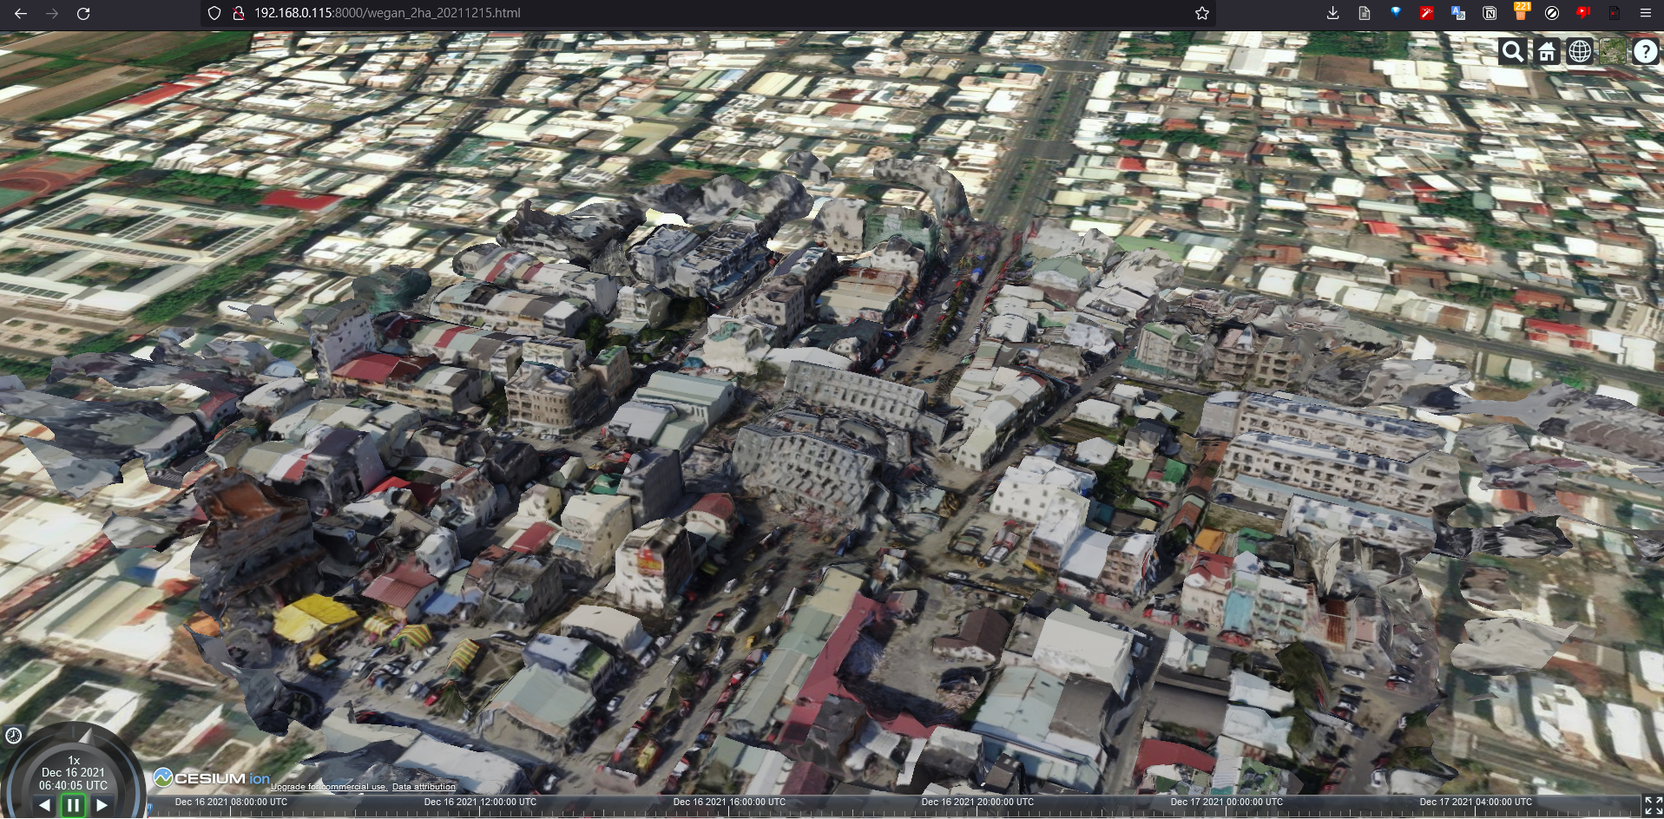
http://192.168.0.115:8000/wegan_2ha_20211215.html

Slide 21


技術研發部 三課 (遙測技術與AI解決方案)
演算法工程師

